Slide 1
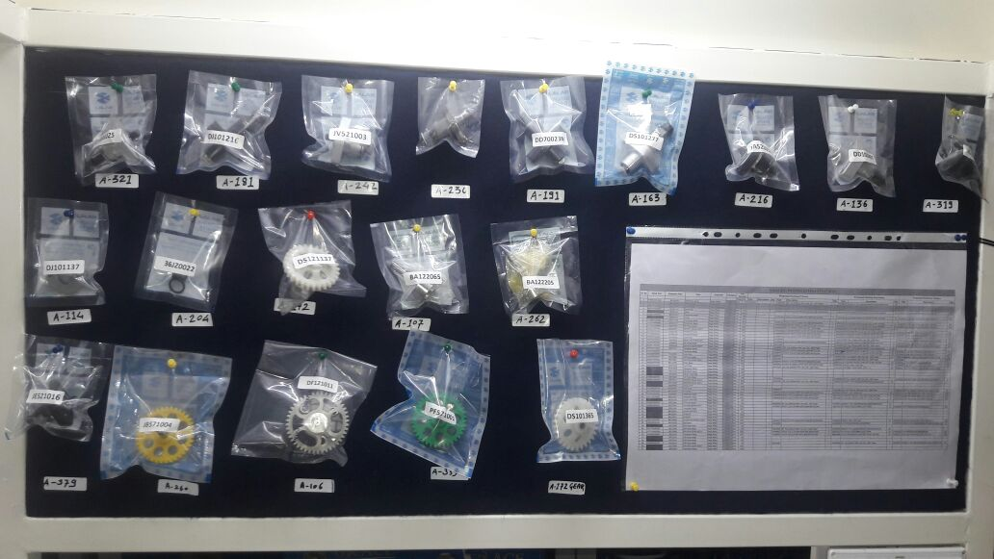
P15
TPM CIRCLE NO :-
ACTIVITY
KK
QM
PM
JH
SHE
OT
DM
E&T
KAIZEN IDEA SHEET
TPM CIRCLE NAME:
LOSS NO. / STEP
DEPT :- Dispatch
RESULT AREA
P
Q
A
C
D
S
M
CELL:-SPD
CELL NAME:-BAJAJ & AFTER MKT
MACHINE / STAGE :-
OPERATION :- PACKING
KAIZEN THEME : To Increase the operator part Visibility while picking and Packing
NO PART IDENTIFICATION ON DISPLAY BOARD
IDEA :- All part display on board
Problem present status :-
COUNTERMEASURE:-
BENCHMARK
2
TARGET
0
KAIZEN START
01.07.2016
TDC
04.07.2016
KAIZEN FINISH
05.07.2016
TEAM MEMBERS :
1.Priya Deshmukh 2. Abhishekh Gored
BENEFITS :-
1.100 % Accuracy for material visibility
Before
After
KAIZEN SUSTENANCE
WHY - WHY ANALYSIS :-
Possibility of wrong material picking and packing
Possibility of wrong material dispatch to customer
No part knowledge to operator
RESULT :-
Mix –up Complaints should be zero
Getting part knowledge to operator
WHAT TO DO:- To Maintain display board
HOW TO DO:- To Ensure all spd part’s display on board
FREQUENCY :- To check on daily basis
ROOT CAUSE :-
No Part Knowledge
REGISTRATION NO. & DATE :
SCOPE & PLAN FOR HORIZONTAL DEPLOYMENT
REGISTERED BY :-
SR.
NO.
CELL
TARGET
RESPONSIBILITY
STATUS
MANAGER’S SIGN :-
1
After Market
Done

